Slide 1
shopping mall sales Data(eda)
Sayan Karmakar
Last Update = 28th of December, 2022

Slide 2
ABOUT my journey
So, I took this Data from Kaggel cleaned it founded some insides and Answer some questions that will help our stakeholder to make data driven dissecans.

Slide 3
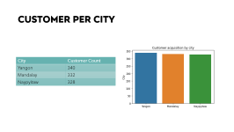
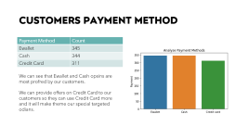
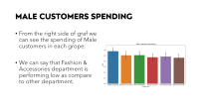
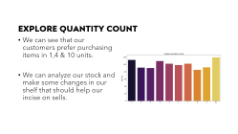
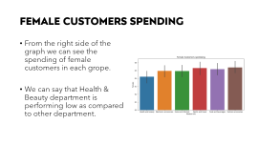
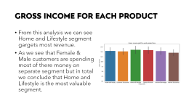

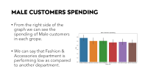

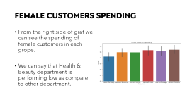
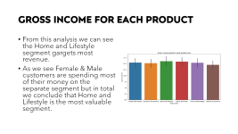
PROBLEM
Customer Spending as Per Gender
Customer Per City
Customers Payment Method
Gross Income for Each Product
Explore Quantity Count

Slide 4
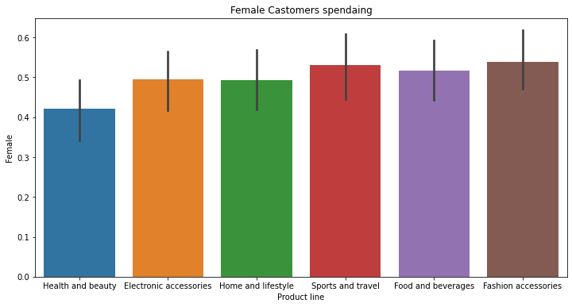
Female customers spending
From the right side of the graph we can see the spending of female customers in each grope.
We can say that Health & Beauty department is performing low as compared to other department.

Slide 5
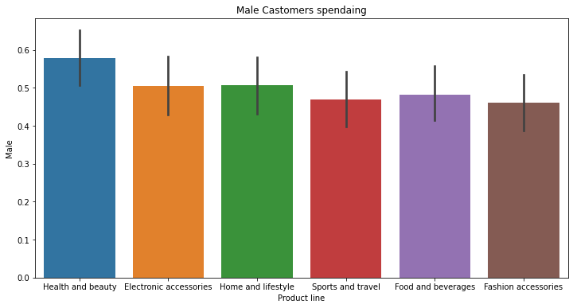
male customers spending
From the right side of the graph we can see the spending of Male customers in each grope.
We can say that Fashion & Accessories department is performing low as compared to another department.

Slide 6
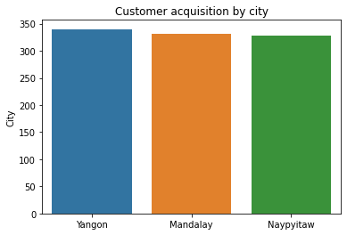
Customer per city
City | Customer Count
Yangon | 340
Mandalay | 332
Naypyitaw | 328

Slide 7
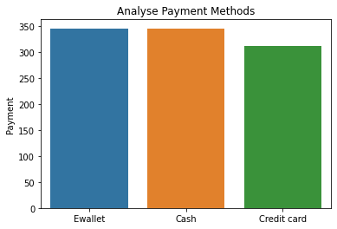
CUSTOMERS Payment Method
Payment Method | Count
Ewallet | 345
Cash | 344
Credit Card | 311
We can see that Ewallet and Cash opsins are most profred by our customers.
We can provide offers on Credit cards to our customers so they can use Credit Cards more and it will make them our special targeted odians.

Slide 8
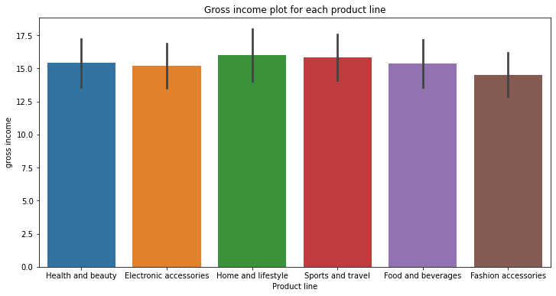
Gross Income for Each Product
From this analysis we can see the Home and Lifestyle segment gargets most revenue.
As we see Female & Male customers are spending most of their money on the separate segment but in total we conclude that Home and Lifestyle is the most valuable segment.

Slide 9
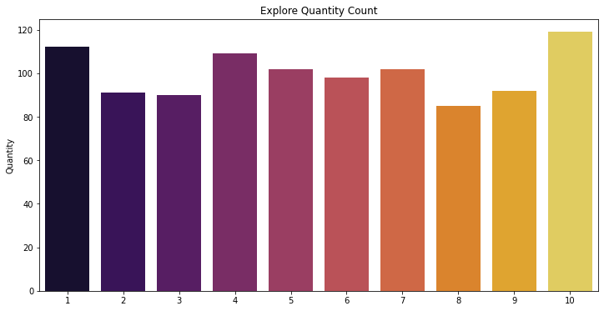
Explore Quantity Count
We can see that our customers prefer purchasing items in 1,4 & 10 units.
We can analyze our stock and make some changes in our shelf that should help our incise on sells.

Slide 10
SUMMARY
Active Supervisor with 5+ years of work experience effectively handling clients and now transforming my career as entry level Data Analyst to help company with my data cleaning skills and more.

Slide 11
THANK YOU
Sayan Karmakar
9123031767
sayanjoy17@gmail.com

